Slide 1
Atomic Structure
The Bohr Model

Slide 2
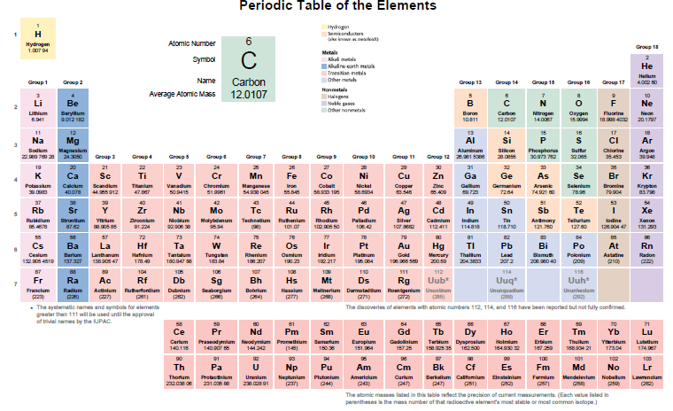

Slide 3
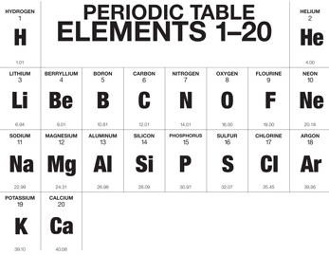

Slide 4
Bohr Model of the Atom
Electrons are in the orbits around the nucleus
Protons and
Neutrons
Are in the nucleus

Slide 5
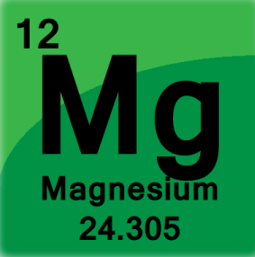
Find your number of protons
and neutrons and put in
nucleus
Fill in electrons starting
from innermost ring
then moving outward
Atomic Mass ________________________
Atomic Number______________________
# protons___________________________
# electrons _________________________
# neutrons__________________________

Slide 6
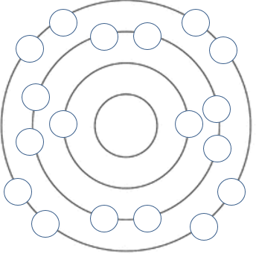

Slide 9
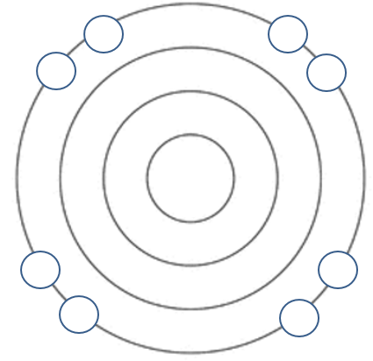
Outermost electrons are called the valence electrons
These make the atoms want to react or bond

Slide 10
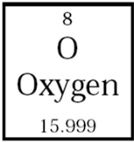
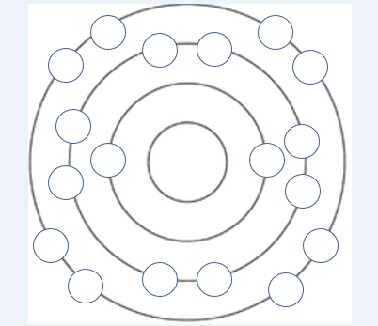
Atomic Mass ________________________
Atomic Number______________________
# protons___________________________
# electrons _________________________
# neutrons__________________________

Slide 11
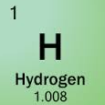
Atomic Mass ________________________
Atomic Number______________________
# protons___________________________
# electrons _________________________
# neutrons__________________________

Slide 12
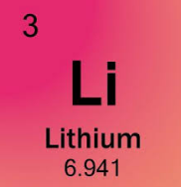
Atomic Mass ________________________
Atomic Number______________________
# protons___________________________
# electrons _________________________
# neutrons__________________________

Slide 13
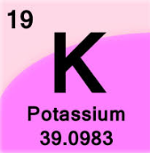
Atomic Mass ________________________
Atomic Number______________________
# protons___________________________
# electrons _________________________
# neutrons__________________________

Slide 14
What do these elements have in common?

Slide 15
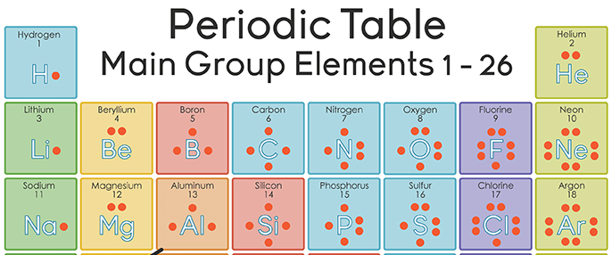

Slide 16
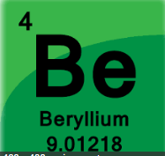
Atomic Mass ________________________
Atomic Number______________________
# protons___________________________
# electrons _________________________
# neutrons__________________________

Slide 17
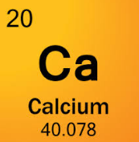
Atomic Mass ________________________
Atomic Number______________________
# protons___________________________
# electrons _________________________
# neutrons__________________________

Slide 18
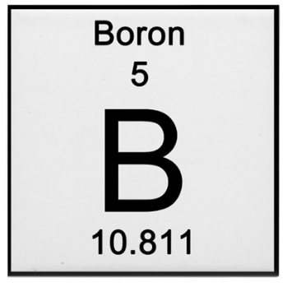
Atomic Mass ________________________
Atomic Number______________________
# protons___________________________
# electrons _________________________
# neutrons__________________________

Slide 19
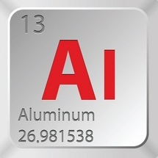
Atomic Mass ________________________
Atomic Number______________________
# protons___________________________
# electrons _________________________
# neutrons__________________________

Slide 20
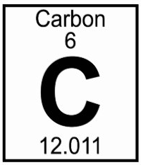
Atomic Mass ________________________
Atomic Number______________________
# protons___________________________
# electrons _________________________
# neutrons__________________________

Slide 21
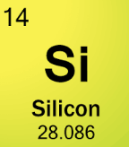
Atomic Mass ________________________
Atomic Number______________________
# protons___________________________
# electrons _________________________
# neutrons__________________________

Slide 22
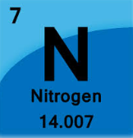
Atomic Mass ________________________
Atomic Number______________________
# protons___________________________
# electrons _________________________
# neutrons__________________________

Slide 23
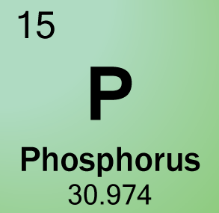
Atomic Mass ________________________
Atomic Number______________________
# protons___________________________
# electrons _________________________
# neutrons__________________________

Slide 24
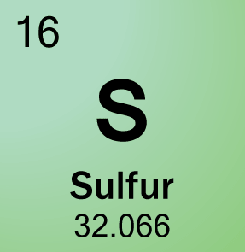
Atomic Mass ________________________
Atomic Number______________________
# protons___________________________
# electrons _________________________
# neutrons__________________________

Slide 25
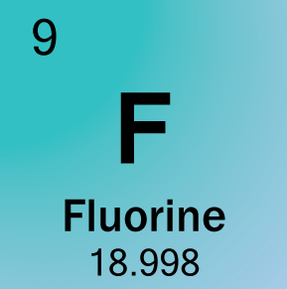
Atomic Mass ________________________
Atomic Number______________________
# protons___________________________
# electrons _________________________
# neutrons__________________________

Slide 26
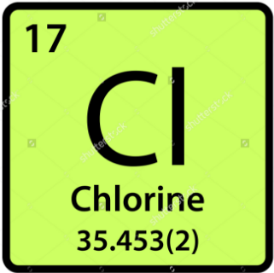
Atomic Mass ________________________
Atomic Number______________________
# protons___________________________
# electrons _________________________
# neutrons__________________________

Slide 27
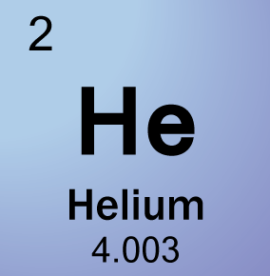
Atomic Mass ________________________
Atomic Number______________________
# protons___________________________
# electrons _________________________
# neutrons__________________________

Slide 28
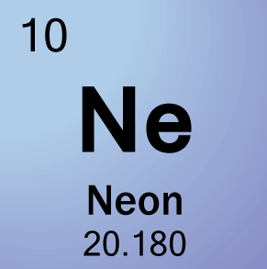
Atomic Mass ________________________
Atomic Number______________________
# protons___________________________
# electrons _________________________
# neutrons__________________________

Slide 29
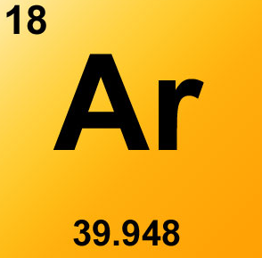
Atomic Mass ________________________
Atomic Number______________________
# protons___________________________
# electrons _________________________
# neutrons__________________________

